Slide 1
AngularJS
Node.JS introduction
Notes:
<number>

Slide 2

What is Node.JS?
v8 JavaScript runtime
Event driven
Non-blocking standard libraries
Most APIs speak streams
Provides a package manager and module system

Slide 3

JavaScript everywhere
Code reuse
Same programming culture on client and server
Lots of JavaScript programmers

Slide 4
Node.JS standrard libraries
Asynchronous by default
Low level
HTTP is first class citizen

Slide 5
NPM – Node Package Manager
Handles and resolves dependencies
More than 300 000 modules available
package.json – dependencies definition

Slide 6
Routes with Express
Respond to HTTP requests with a callback
Supports variable placement in routes
Easy to serve JSON
Example
app.get("/greeting", function(req,res) {
res.send("Hello, "+req.query.name+"!");
});

Slide 7
Express routing examples
app.get(’/users/:id?’, function(req,res) {
var id = req.params.id;
res.send( id ? 'user'+id : 'users’);
});
app.post(’/users/:id.:format’, function(req,res) {
var id = req.params.id;
var format = req.params.format;
res.send( 'user '+id+ ’ format : ’+format);
});

Slide 8
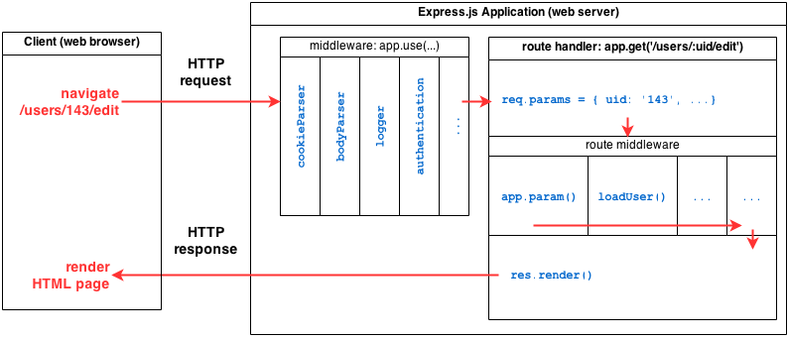
NodeJS + Express application structure

Slide 9
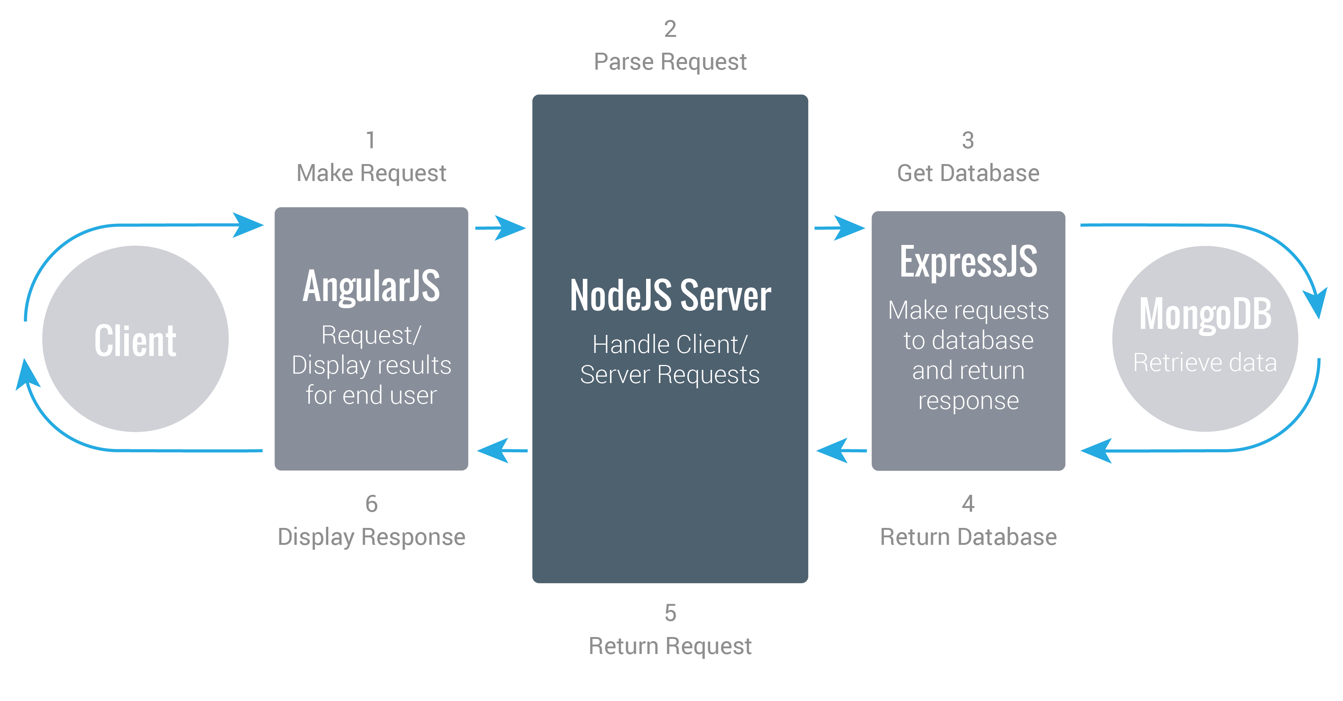
MEAN stack in work
MEAN = MongoDb+Express+AngularJS+NodeJS

Slide 10
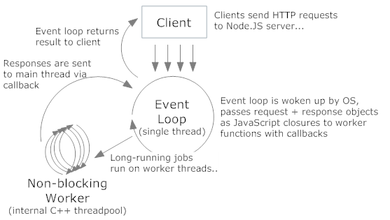
NodeJS processing model

Slide 11
Task 2
Create the server side for the simplest application

Slide 12
Task 3
Notes application

Slide 13
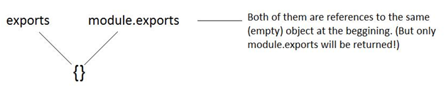
Modules in NodeJS: CommonJS
// module.js
exports.name = function() { console.log('My name is John'); };
var module= require('./module.js'); module.name(); //
Notes:
Initially, module.exports=exports, and the require function returns the object module.exportsrefers to.
if we add property to the object, say exports.a=1, then module.exports and exports still refer to the same object
if we override one of them, for example, exports=function(){}, then they are different now: exports refers to a new object and module.exports refer to the original object. And if we requre the file, it will not return the new object, since module.exports is not refer to the new object.
<number>

Slide 14
Session support in NodeJS
app.use(session({
secret: 'angular_tutorial',
resave: true,
saveUninitialized: true,
}));
app.get("/notes", function(req,res) {
res.send(req.session.notes||[]);
});
app.post("/notes", function(req, res) {
if (!req.session.notes) {
req.session.notes = [];
req.session.last_note_id = 0;
}
var note = req.body;
note.id = req.session.last_note_id;
req.session.last_note_id++;
req.session.notes.push(note);
res.end();
});

Slide 15
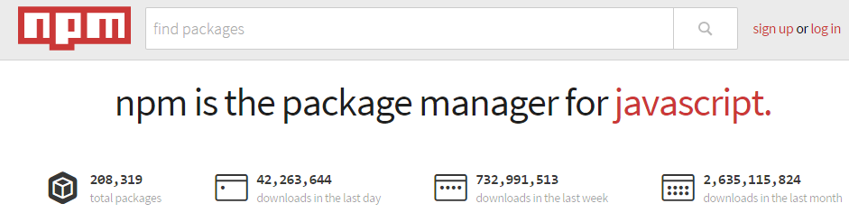
NPM site
https://www.npmjs.com

Slide 16
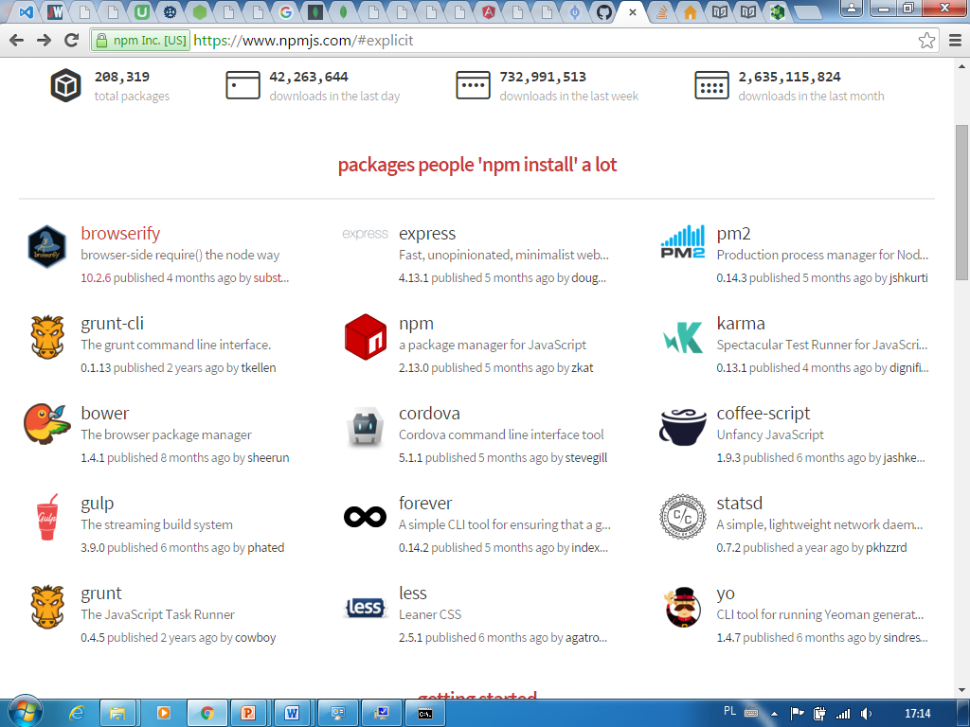
Popular NPM modules overview

Slide 17
Forever module
Installation:
sudo npm install -g forever
Use forever -w, instead of node to start your app:
$ forever -w app.js

Slide 18
Task 4
Store notes in session

Slide 19
Task 5
Store session in mongodb

Slide 20
Reading from files
var fs = require("fs");
//Asynchronous read
fs.readFile('input.txt', function (err, data) {
if (err) {
return console.error(err);
}
console.log("Asynchronous read: " + data.toString());
});
//Synchronous read
var data = fs.readFileSync('input.txt');
console.log("Synchronous read: " + data.toString());
console.log("Program Ended");
Notes:
<number>

Slide 21
Writing to files
var fs = require("fs");
console.log("Going to write into existing file");
fs.writeFile('input.txt', 'Simply Easy Learning!', function(err) {
if (err) {
return console.error(err);
}
console.log("Data written successfully!");
console.log("Let's read newly written data");
fs.readFile('input.txt', function (err, data) {
if (err) {
return console.error(err);
}
console.log("Asynchronous read: " + data.toString());
});
});

Slide 22
Task 6
Store notes in files

